Slide 1

‘Five’ is the number of bunnies and hats: Children’s understanding of cardinal extension and exact number
Khuyen N. Le, Christine Kwon, Mincong Wu & David Barner
CogSci 2024
Notes:
Hello everyone! My name is Khuyen, and I’m excited to present our paper titled ‘Five’ is the number of bunnies and hats: Children’s understanding of cardinal extension and exact number.

Slide 2
Notes:
To begin I want to walk you through a quick game. In this game, I’ll show you an image for a few seconds. Afterwards, the image will disappear, and I’ll ask you a question. Here is the first image.

Slide 3

Notes:
[wait 3s]

Slide 4
Notes:
Alright, here’s the question: how many bunnies were there? I’m guessing it is quite easy to remember that it was 5 bunnies. Here’s another image.

Slide 5


Notes:
[wait 3s]

Slide 6
Notes:
Okay, how many bunnies were there? I guess that’s a little bit more difficult in the previous question, right? But what might make this easier, is if the bunnies have left their hats behind, like this:

Slide 7
Notes:
As numerate adults, a strategy we might choose to do is to count the hats to find out the number of bunnies. While this might seem intuitive to us, it involves 2 distinct abilities.

Slide 8
Notes:
Firstly, we need to recognize that the bunnies and the hats are exactly equal, because they are in one-to-one correspondence – each bunny has a hat.

Slide 9
5 bunnies
5 hats
Notes:
Secondly, we need to recognize that 2 sets can only be labeled with the same number words if they are exactly equal.

Slide 10
CARDINAL EXTENSION
5 bunnies
5 hats
Notes:
Understanding both of these principles forms the understanding of ‘cardinal extension’ – the understanding that you use when you, for example, count the number of hats to determine the number of bunnies.

Slide 11
CARDINAL EXTENSION
5 bunnies
5 hats
Notes:
Now this is a lighthearted example about bunnies and hats, but understanding cardinal extension integrates both non-linguistic reasoning about exact equality between sets, and linguistic knowledge of how number words encode exact cardinalities.

Slide 12



CARDINAL EXTENSION
5 bunnies
5 hats
Notes:
This allows numerate adults to reason about exact number, such as lighting the correct number of candles for a loved one’s birthday, setting out enough chairs for a meeting, or determining if you have an appropriate sample size after a power analysis.
So how do children acquire an understanding of cardinal extension? One way to frame this question is to look at children’s developing understanding of number words and counting.

Slide 13
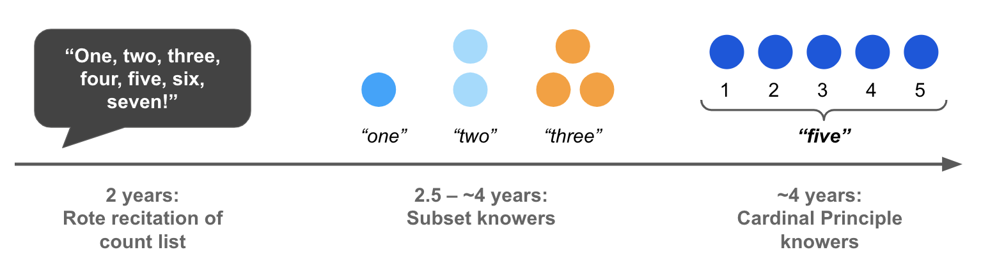
Children’s Understanding of Numbers & Counting
Wynn, 1990, 1992
Notes:
Children’s understanding of numbers and counting follow a well-established trajectory.

Slide 14
Children’s Understanding of Numbers & Counting
Wynn, 1990, 1992
Notes:
Firstly, children as young as 2 years old can recite the count list as a rote procedure, without understanding the meaning of numbers. When asked to construct a set of numbers they ‘know’, they might grab a bunch of items, like this.

Slide 15

Children’s Understanding of Numbers & Counting
Wynn, 1990, 1992

Slide 16
Children’s Understanding of Numbers & Counting
Wynn, 1990, 1992
Notes:
At about 2.5-4 years old, children learn the meaning of number words in a piecemeal fashion. They understand a subset meaning of numbers, hence they are called subset knowers. For example, they might know the meaning of ‘one’ and can

Slide 17
Children’s Understanding of Numbers & Counting
Wynn, 1990, 1992
Notes:
Make sets of one items, but do not know the meanings of two and three.

Slide 18
Children’s Understanding of Numbers & Counting
Wynn, 1990, 1992
Notes:
Then children learn the meaning of two

Slide 19
Children’s Understanding of Numbers & Counting
Wynn, 1990, 1992
Notes:
Then of three.

Slide 20
Children’s Understanding of Numbers & Counting
Wynn, 1990, 1992
Notes:
At about 4 years old, children seem to discover that they can use counting to construct sets of any number words they know. At this point, they are called cardinal principle knowers.

Slide 21
So… where does understanding of cardinal extension arise?
Notes:
So where in this timeline do children understand cardinal extension?

Slide 22
H1: Understanding of cardinal extension arises when the first number words are acquired
(Gelman & Gallistel, 1986; Sarnecka & Gelman, 2004)
Notes:
One possibility is that this arises when the first number words are acquired. Perhaps just learning the first few number words is sufficient to support an inference that all number words denote exact numerosities, and therefore only sets with the same number of items should receive the same labels.

Slide 23
H2: Understanding of cardinal extension comes with, or after learning the CP
(Carey, 2004, 2009)
Notes:
Alternatively, understanding of cardinal extension might come at or after learning the CP. Perhaps learning the CP reflects an understanding that counting establishes a 1-1 correspondence between labels and counted objects. Therefore, only sets of objects in 1-1 correspondence would receive the same number label. Additionally, while there are previous results showing that CP-knowers are better than subset-knowers at tests of cardinal extension, CP-knowers rarely perform at ceiling at these tasks, opening up the possibility that learning the CP is not sufficient to understand cardinal extension.

Slide 24
Study 1: When do children understand cardinal extension?
Notes:
So our first study aims to target the question of when children understand cardinal extension

Slide 25
Study 1: When do children understand cardinal extension?
n=82 English-speaking children, 2-5yos
Give-N task to categorize participants
38 subset-knowers: can only construct sets up to 4.
44 CP-knowers: can construct sets of 5 or 6.
Highest Count task
* Not significant for any models
Notes:
We tested 82 English-speaking children from 2-5 yos
These children receive a Give-a-Number task,
And we categorized them into 38 subset knowers, who can only construct sets of up to 4
And 44 CP knowers, who can only construct sets of 5 or 6.
They are also given a Highest Count task that measures how high they can count. As a spoiler, this was not significant for any analysis, so I won’t be describing this in-depth.

Slide 26




Study 1: When do children understand cardinal extension?
Notes:
Then they complete a cardinal extension task. In this study, they see 2 sets of animals. Each group of animals carry a different item: the bunnies have blue hats and the lions have red hats.

Slide 27
Study 1: When do children understand cardinal extension?
How many bunnies are in the school?
Notes:
The bunnies and lions put the items down, then they go into the school. After that, the child is asked “How many bunnies are in the school.”

Slide 28
Study 1: When do children understand cardinal extension?
Dependent variables:
Select the correct set (pointing to the blue hats)
Infer the correct number (counting to 3)
6 trials
Small sizes (1:2, 1:3, 2:3)
Large sizes (5:7, 5:8, 6:7)
Analysis: Regression with Age, Knower Level, Set Size, Knower Level * Set Size
Notes:
Here is a quick schematic of what the trials look like. We know that we can count the blue hats to tell the number of bunnies.
There are 2 dependent variables that we care about…
Each participant sees 6 trials
Analysis: regression…

Slide 29
Study 1: When do children understand cardinal extension?
Dependent variables:
Select the correct set (pointing to the blue hats)
Infer the correct number (counting to 3)
6 trials
Small sizes (1:2, 1:3, 2:3)
Large sizes (5:7, 5:8, 6:7)
Analysis: Regression with Age, Knower Level, Set Size, Knower Level * Set Size
Notes:
I’ll first present results regarding whether kids choose the correct set.

Slide 30
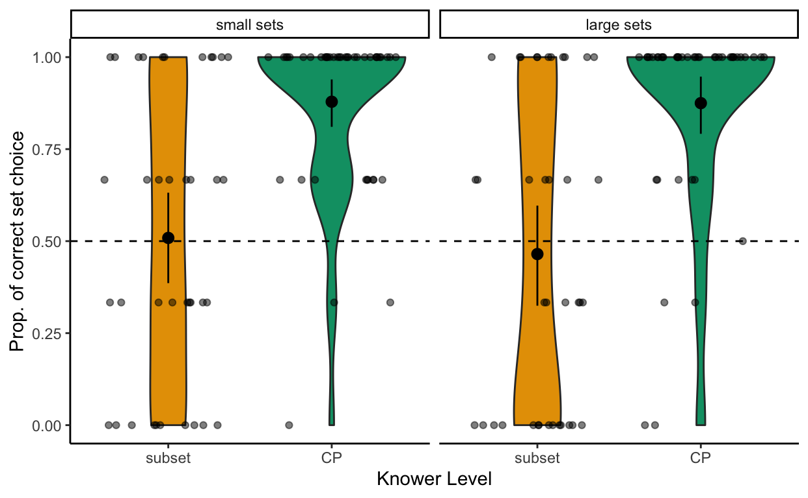
Study 1: When do children understand cardinal extension?
Notes:
The y-axis
The x-axis
Small sets vs large sets.

Slide 31
Study 1: When do children understand cardinal extension?
Notes:
What we found was that subset knowers were at chance,

Slide 32
Study 1: When do children understand cardinal extension?
Notes:
while CP-knowers performed above chance.

Slide 33
Study 1: When do children understand cardinal extension?
Difference between CP and subset knowers remains when controlled for age.
Only 60% of CP knowers performed at ceiling.
Notes:
The difference between CP and subset knowers hold even when controlled for age.
However, not all CP knowers succeed at the task. Only 60% of CP knowers performed at ceiling, suggesting that there are some individual differences. This shows that understanding of cardinal extension develops after kids learn how to construct and label large sets.

Slide 34
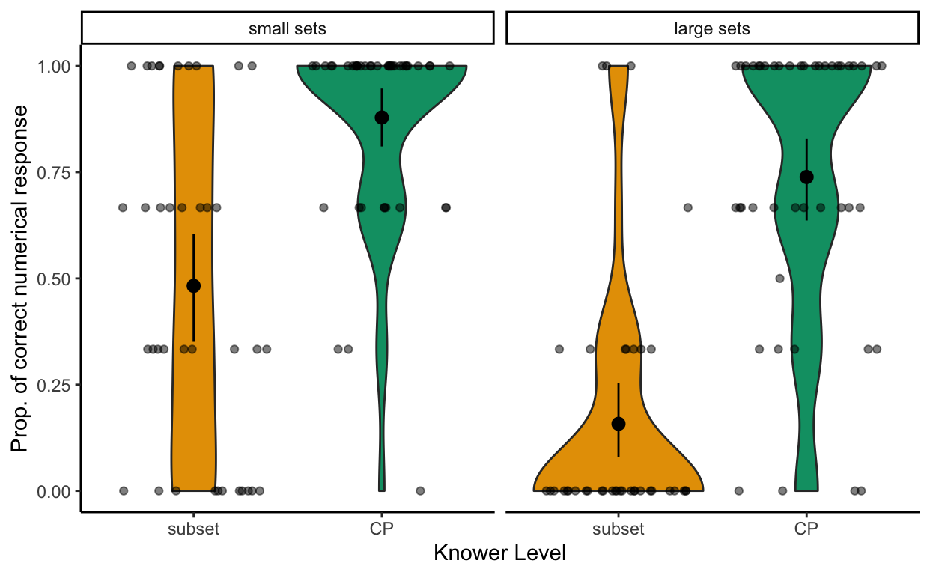
Study 1: When do children understand cardinal extension?
Notes:
I’ll also quickly show the results regarding whether kids provide the correct number of items. To be counted as successful in this metric, they have to not only choose the correct item set to count, but also count it accurately.

Slide 35
Study 1: When do children understand cardinal extension?
Children perform better in small sets.
Knower Level * Set Size is significant.
Notes:
Here we find a similar trend of CP knowers performing better than subset knowers. Additionally, children perform better in small sets, and there is also an interaction between knower level and set size.

Slide 36
Recap: CP knowers understand cardinal extension, while subset knowers don’t.
Notes:
Study 1 showed that CP knowers understand cardinal extension, while subset knowers don’t. But there is an open question regarding how CP knowers succeed at this task. How did they know that

Slide 37
Recap: CP knowers understand cardinal extension, while subset knowers don’t.
Notes:
How did CP knowers know that they can count the blue hats to tell the number of bunnies?

Slide 38
Recap: CP knowers understand cardinal extension, while subset knowers don’t.
1
2
3
4
5
Notes:
One possibility is that they select the correct
item set through noticing a 1-to-1 correspondence between
items and animals (e.g., bunnies and hats).

Slide 39
Recap: CP knowers understand cardinal extension, while subset knowers don’t.
1
2
≈
3
4
5
Notes:
Alternatively, they might compare the approximate quantity of these
sets (e.g., ‘approximately seven’ bunnies is equal to ‘approximately
seven’ hats).

Slide 40
Study 2: Is CP knowers’ success in cardinal extension based on exact equality?
Notes:
To differentiate between these 2 possibilities, we conducted a follow-up study, looking at whether CP knowers….

Slide 41

Study 2: Is CP knowers’ success in cardinal extension based on exact equality?
Notes:
In this study, there is only 1 set of animals, the bunnies. But the animals carry 2 sets of items: hats and books. You’ll notice that one of the bunnies is missing a book, and this is critical for our research question, which I’ll elaborate further.

Slide 42
Study 2: Is CP knowers’ success in cardinal extension based on exact equality?
How many bunnies are in the school?
Notes:
But to finish explaining the trial, the bunnies then disappear into the school like what happened in study 1. Then children are also asked, how many bunnies are in the school. Again, as adults we know we can count the hats to tell the number of bunnies.

Slide 43
Study 2: Is CP knowers’ success in cardinal extension based on exact equality?
Notes:
Critically, we will differentiate between reasoning about exact vs. approximate quantities through 2 trial types. In the first trial type as shown here, the item sets are perceptually discriminable, with a ratio of 2:1 or larger.

Slide 44
Study 2: Is CP knowers’ success in cardinal extension based on exact equality?
Notes:
In the first trial type as shown here, the item sets are perceptually discriminable, with a ratio of 2:1 or larger.

Slide 45
Study 2: Is CP knowers’ success in cardinal extension based on exact equality?
Notes:
In the other trial type, which we call the ‘off-by-one’ trials, the correct item set only differ from the wrong one by 1 item. We reason that if CP knowers reason about exact equality, then they should succeed

Slide 46

Study 2: Is CP knowers’ success in cardinal extension based on exact equality?
Notes:
At both these trial types. Meanwhile, if they use approximate quantities, then they

Slide 47
Study 2: Is CP knowers’ success in cardinal extension based on exact equality?
Notes:
Meanwhile, if they use approximate quantities, then they

Slide 48

Study 2: Is CP knowers’ success in cardinal extension based on exact equality?
Notes:
Would succeed at the trials with large ratios, but not the off-by-one ratios.

Slide 49
Study 2: Is CP knowers’ success in cardinal extension based on exact equality?
n=78 English-speaking children, 3-5yos
Excluded 18 trials where participants started counting before the bunnies disappear.
All CP-knowers (can construct sets of 6 on Give-N task)
Highest Count task
* Not significant for any models

Slide 50
Study 2: Is CP knowers’ success in cardinal extension based on exact equality?
Dependent variables:
Select the correct set (pointing to the hats)
Infer the correct number (counting to 3)
9 trials
Small (1:2, 1:3, 2:3)
Large, discriminable ratios (5:10, 5:11, 6:12)
Large, off-by-one (9:10, 10:11, 11:12)
Analysis: Regression with Age, Trial Type

Slide 51
Study 2: Is CP knowers’ success in cardinal extension based on exact equality?
Dependent variables:
Select the correct set (pointing to the hats)
Infer the correct number (counting to 3)
9 trials
Small (1:2, 1:3, 2:3)
Large, discriminable ratios (5:10, 5:11, 6:12)
Large, off-by-one (9:10, 10:11, 11:12)
Analysis: Regression with Age, Trial Type
Notes:
For this section, for the sake of time I’ll only focus on children’s choosing the correct set.

Slide 52
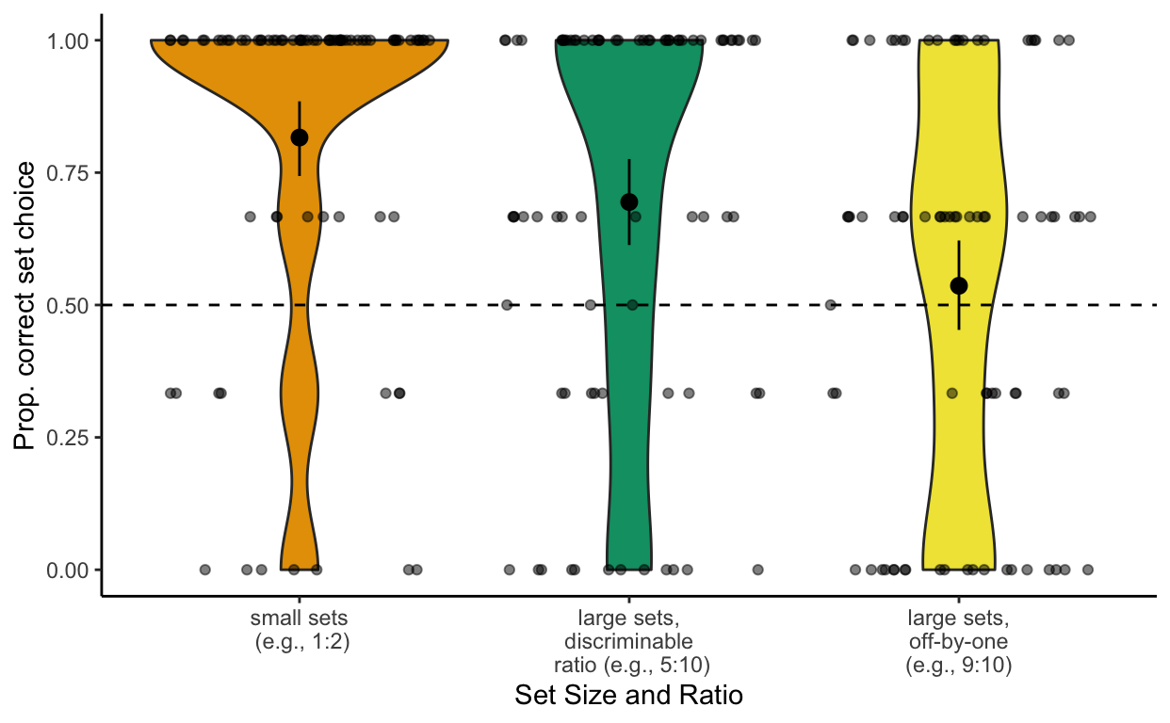
Study 2: Is CP knowers’ success in cardinal extension based on exact equality?
Notes:
Y-axis, x-axis

Slide 53
Study 2: Is CP knowers’ success in cardinal extension based on exact equality?
Notes:
They succeed with the small sets.

Slide 54
Study 2: Is CP knowers’ success in cardinal extension based on exact equality?
Notes:
And also succeeded with large sets with discriminable ratios.

Slide 55
Study 2: Is CP knowers’ success in cardinal extension based on exact equality?
Notes:
But performed at chance when the items only differ by 1.

Slide 56
Study 2: Is CP knowers’ success in cardinal extension based on exact equality?
≈
Notes:
This suggests that CP knowers seem to be using approximate quantities to compare between sets.

Slide 57
Study 2: Is CP knowers’ success in cardinal extension based on exact equality?
≈
Age is not a significant predictor.
Notes:
Additionally, age was not a predictor for CP knowers’ success.

Slide 58
Results
Ongoing Work
Cardinal extension understanding arises after acquiring the Cardinal Principle.
But even CP-knowers judge set equality based on approximate quantity rather than one-to-one correspondence
What explains variability in CP-knowers’ understanding of cardinal extension?
When / How do children learn that one-to-one correspondence establishes exact equality?

Slide 59

Thank you!
Language & Development Lab @ UC San Diego
Parents, teachers, and children who participated.
Contact: khuyenle@ucsd.edu
Scan for preprint
Notes:
That is the end of my presentation. If you are interested in this study, we have a longer version of the paper as a preprint, which you can access through the QR code. Thank you so much for listening and you can contact me through email if you are interested in further discussion!

Slide 60
